Slide 1
ECII/ECSI 3206: Artificial Intelligence [and expert systems] Topic 1: Overview of A.I
By: Edgar Addero

Slide 2
Course Pre-requisites
Basics of computing/computer Science
Basics of statistics
Basics of data structures and algorithms
Basics of Discrete mathematics
Basics of programming

Slide 3
Topics breakdown
Introduction to A.I
A.I agent and Multi-Agent Systems
Search Algorithms and problem Solving
Logic (propositional and predicate calculus) and Truth tables
Fuzzy logic and fuzzy logic systems
Artificial Neural Networks[ANN], Machine Learning and Deep learning
Expert Systems[MYCIN]
Natural Language processing[NLP]
A.I programming Languages[PROLOG, Python for A.I]

Slide 4
Background
Mankind is welcoming the fourth industrial revolution represented by intelligent technologies .
New technologies such as AI, IoT , 5G and bioengineering are integrated into all aspects of human society ; driving changes in global macro trends, such as sustainable social development and economic growth including smart city upgrading, industrial digital transformation, consumer experience etc .

Slide 5
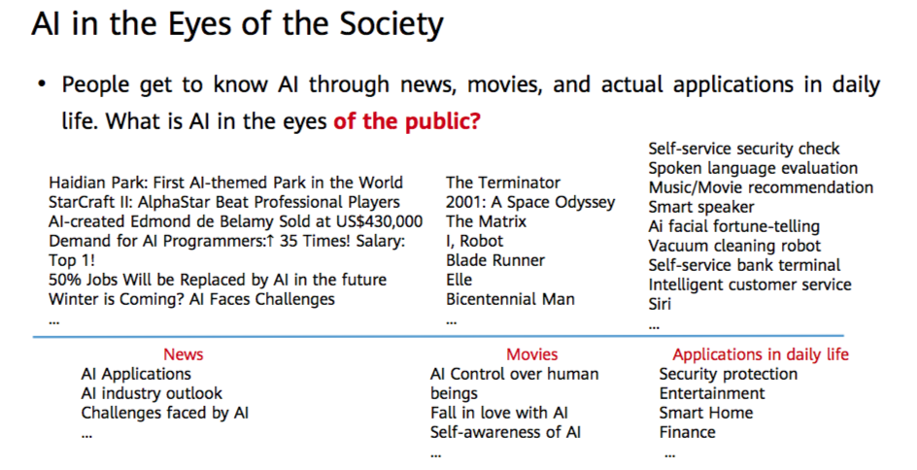
Cont.

Slide 6
Introduction to AI
Intelligence-ability to reason , calculate, learn from experience , adopt , use language, store and retrieve information from memory.
Artificial intelligence-intelligent machines that act and think like human beings
Machine learning-Intelligent systems that learn things without being programmed to do so
Deep learning-Intelligent systems that think like human brains using Artificial Neural networks[ANN]

Slide 7
Introduction to AI
AI-branch of science which deals with helping machines find solutions to complex problems in a human like manner
It involves borrowing the characteristics of human intelligence and applying them as algorithms in a computer friendly manner.
[ above definitions summarized from works by Alan Turing,John McCarthy and marvin minsky]
Characteristics of human intelligence include things such as Reasoning , leaning, problem solving Perception e.t.c

Slide 8
Fields Contributing to A.I
Biology
Philosophy
Mathematics
Psychology
Computer science
Sociology

Slide 9
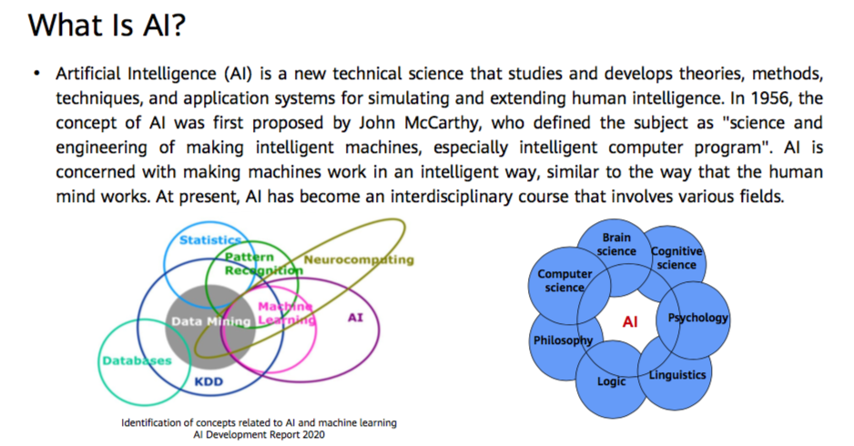
Cont..

Slide 10
General/real world applications of AI
Game playing
Speech recognition
Natural Language processing(NLP)
Computer Vision
Expert systems
Hand writing recognition
Intelligent robots
Consumer marketing
Identification technologies
Intrusion Detection Systems
Machine Translation

Slide 11
History Of AI (from a discipline perspective)
Philosophy[theories of implication and what is considered right(Aristotle and Socrates)]
Mathematics[logic, calculus, Boolean algebra]
Biology[Neural networks and Neural science]
Computation[Turing test and von Neumann architecture]
Psychology[how the human mind operates and how we process infor.]
Evolution[Charles Dawin’s theories of survival for the fittest]
Cognitive science[systems that can learn and interact with their environment]

Slide 12
Components of intelligence
Reasoning
Learning
Problem solving
Perception
Linguistic understanding
Knowledge acquisition

Slide 13
1. Reasoning
Its what provides bases for judgment
Types of reasoning
Inductive reasoning[Use observation to make broad general statements]
Deductive reasoning[Start with a general statement and examine all possibilities so as to come up with a logical conclusion]

Slide 14
2. Learning
It is the activity of gaining knowledge
Types of learning
Auditory
Episodic
Motor
Observational
Perceptual
Spatial
Stimuli response

Slide 15
3. Problem Solving
It is concerned with decision making
In computing , we solve achieve this through the Searching Techniques

Slide 16
4. Perception
Process of acquiring ,then interpreting , then Selecting and finally organizing sensory information.

Slide 17
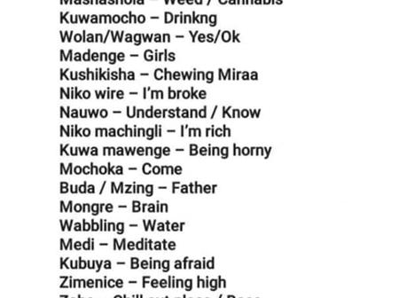

5. Linguistic understanding
Knowledge on how to use a language

Slide 18
6. Knowledge acquisition
Data Vs Information Vs Knowledge
Ability to synthesize new knowledge

Slide 19
Types of Intelligence
Linguistic
Musical
Logical/mathematical
Spatial
Kinesthetic/Bodily
Intrapersonal
interpersonal

Slide 20
Difference between Human and machine intelligence
Human perceive patterns while machines perceive rules and algorithms
Humans store and recall information while machines Use search Algorithms
Humans can figure out missing parts of information but machines do not do this very well.

Slide 21
Perspectives of A.I
Intelligence perspective[aims at making machines act like human beings i.e Turing test]
Business perspective[Review of tools used for solving business problems]
Programming perspective[Study of symbolic programming , problem solving and searching using programming languages]

Slide 22
Task classifications of A.I
Formal tasks[math, geometry, logic games]
Mundane task[ordinary tasks that humans learn since birth]
Expert tasks[engineering, scientific analysis , medical diagnosis]

Slide 23
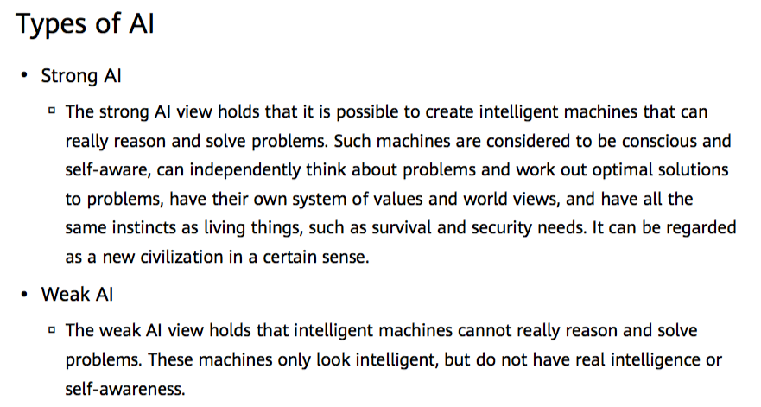

Slide 24
Research areas /fields in A.I
Neural networks[brain models and pattern recognition]
Expert systems[autopilot/self navigation systems]
Robotics[autonomous machines(robo cup)]
Fuzzy logic systems[Electronics controls
Natural Language processing[machine translation]
Speech recognition[ Siri, Alexa]
Computer vision[object recognition]
Evolutionary computation[genetic algorithms]
Machine learning

Slide 25
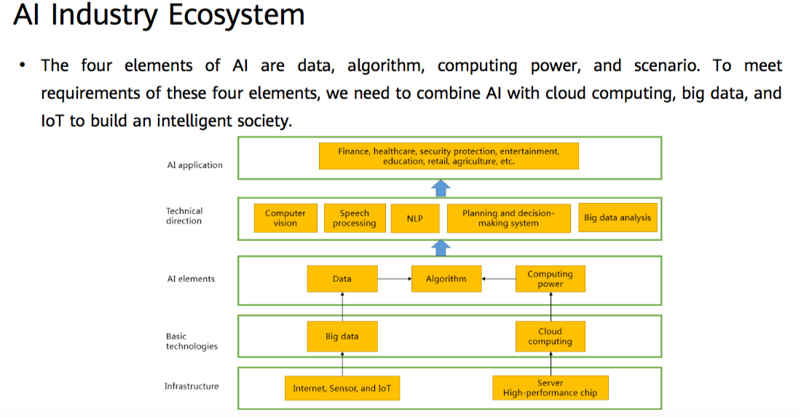

Slide 26
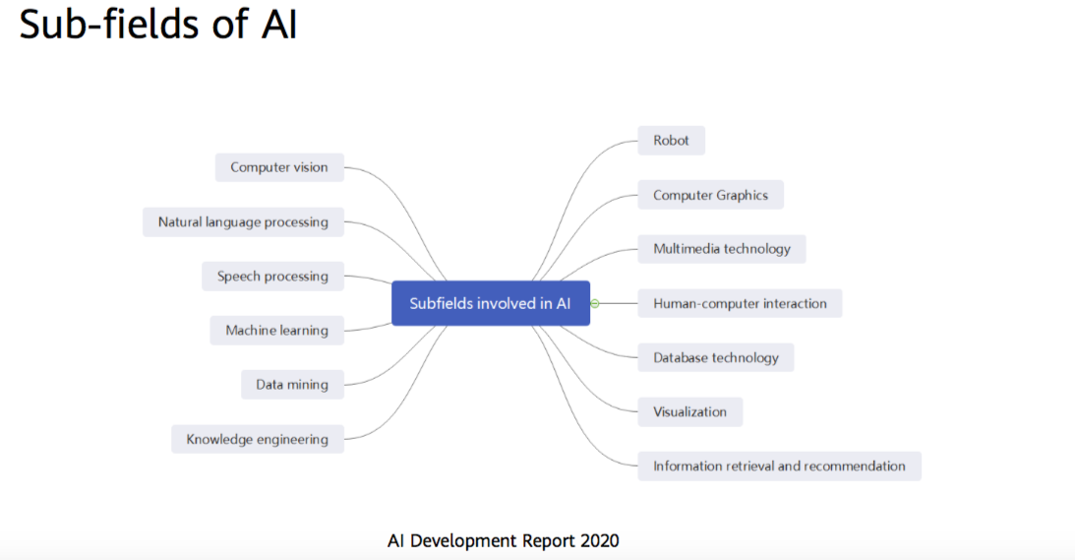

Slide 27
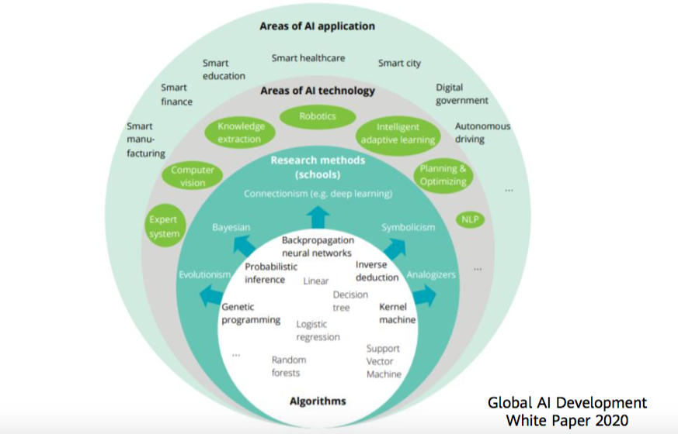
Technical Fields and Application Fields of AI

Slide 28
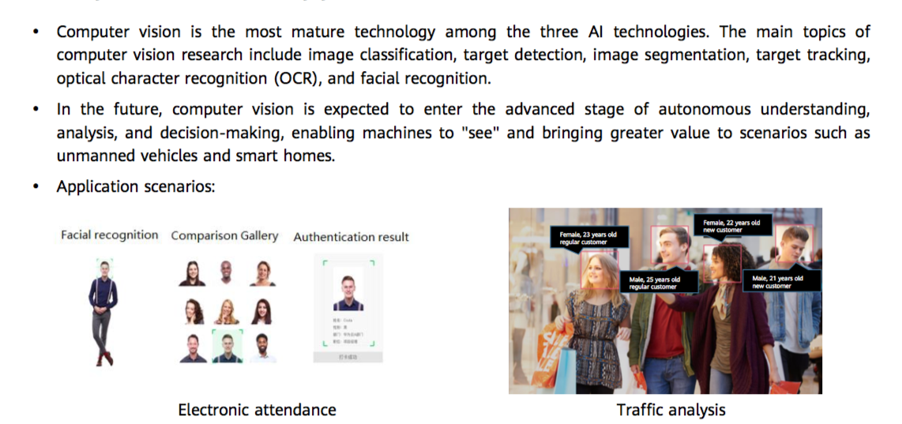
Computer Vision Application Scenario (1)

Slide 29
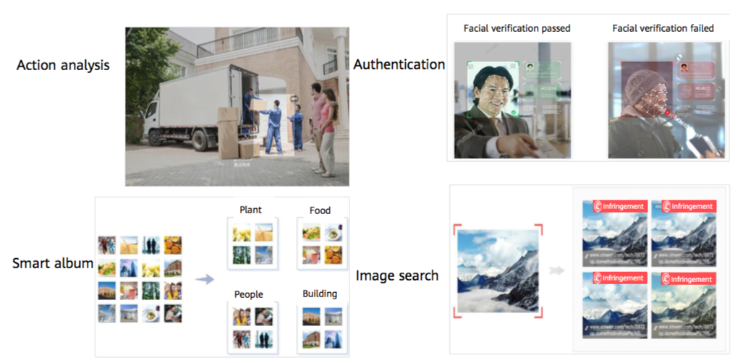
Computer Vision Application Scenario (2)

Slide 30
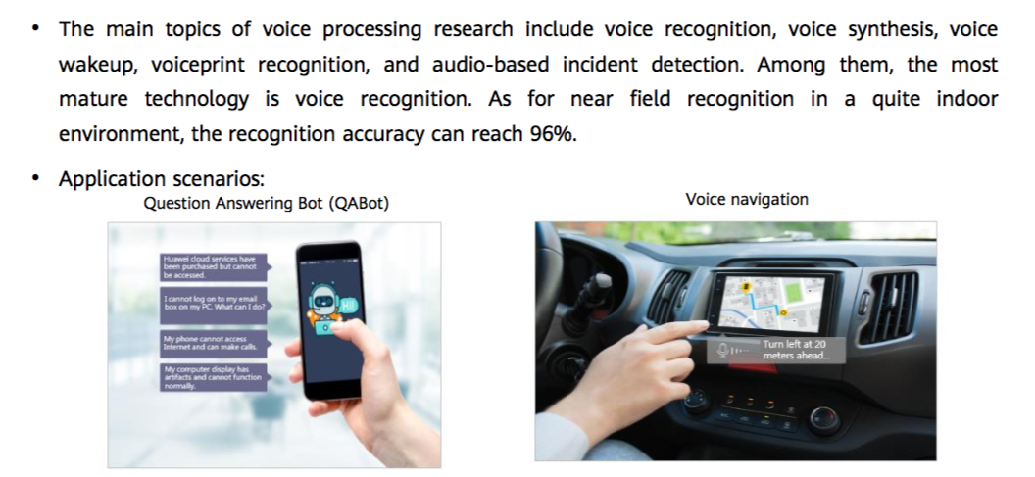
Voice Processing Application Scenario (1)

Slide 31
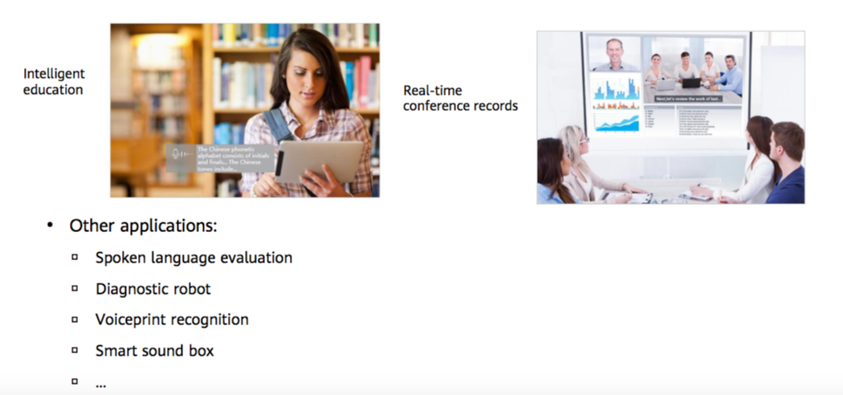
Voice Processing Application Scenario (2)

Slide 32
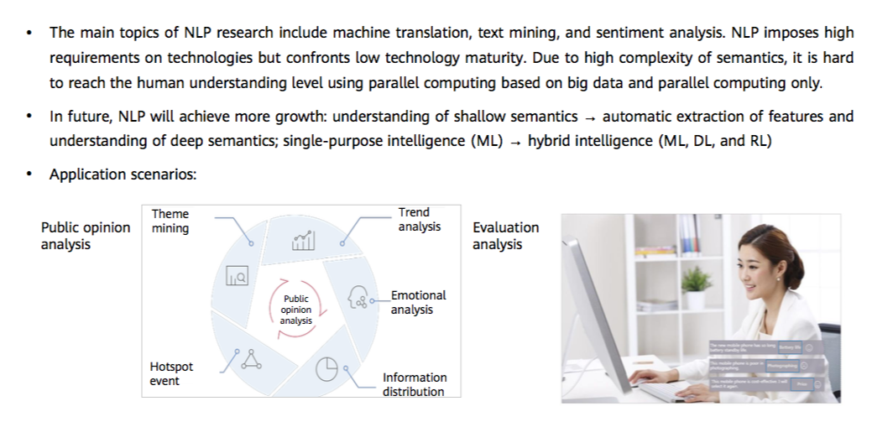
NLP Application Scenario (1)

Slide 33
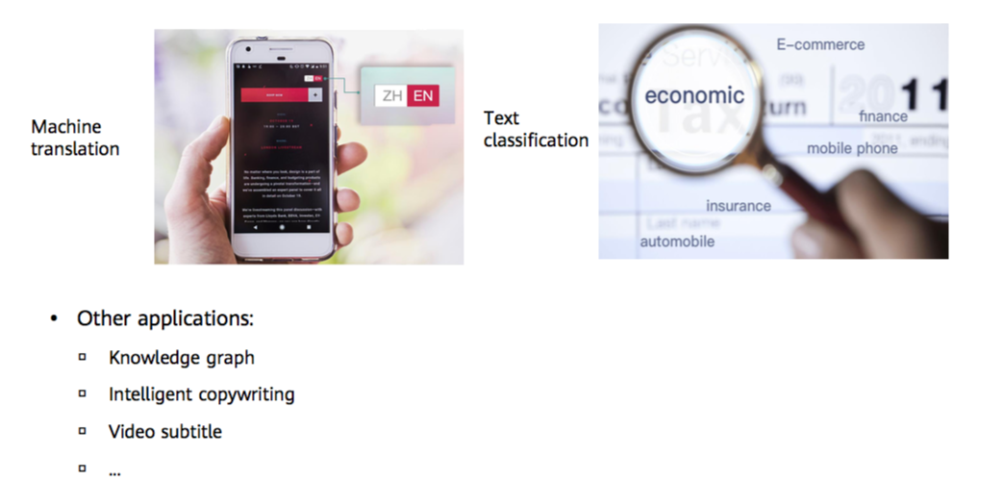
NLP Application Scenario (2)

Slide 34
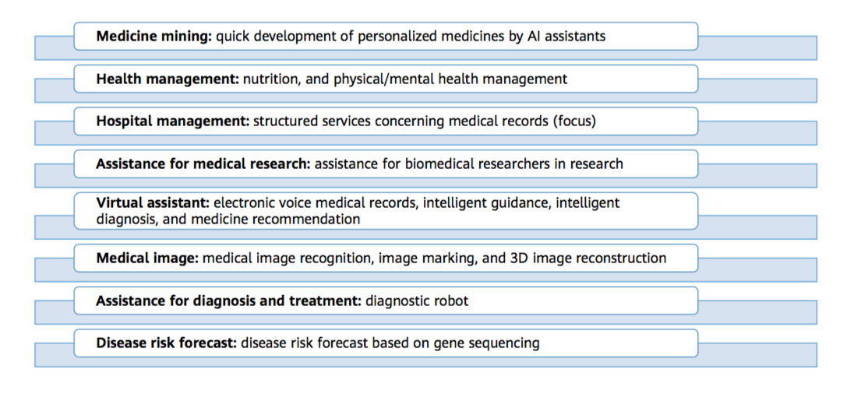
AI Application field- Intelligent Healthcare

Slide 35
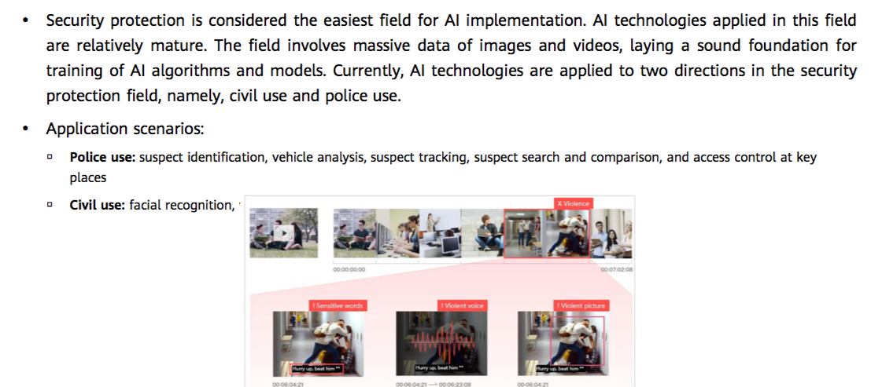
AI Application field- Intelligent Security

Slide 36
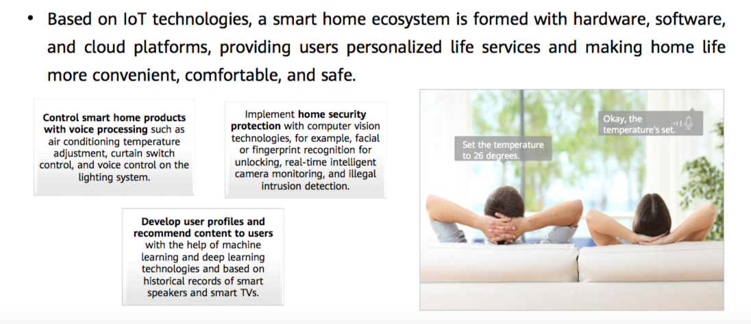
AI Application field- Smart Homes

Slide 37
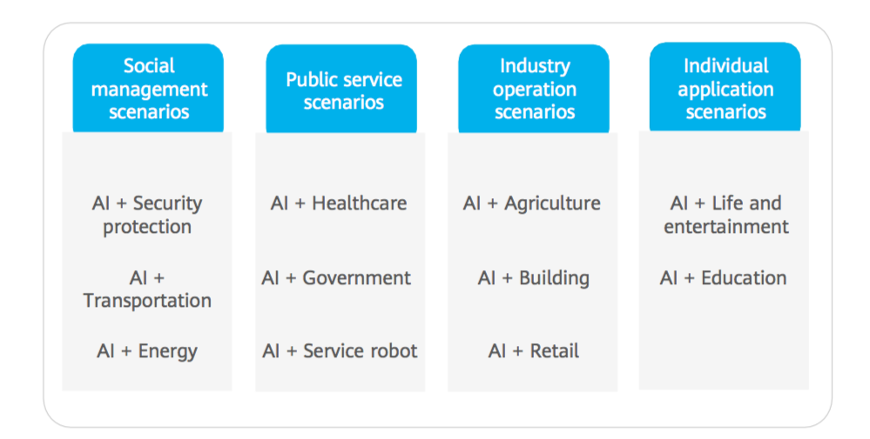
AI Application field- Smart Cities

Slide 38
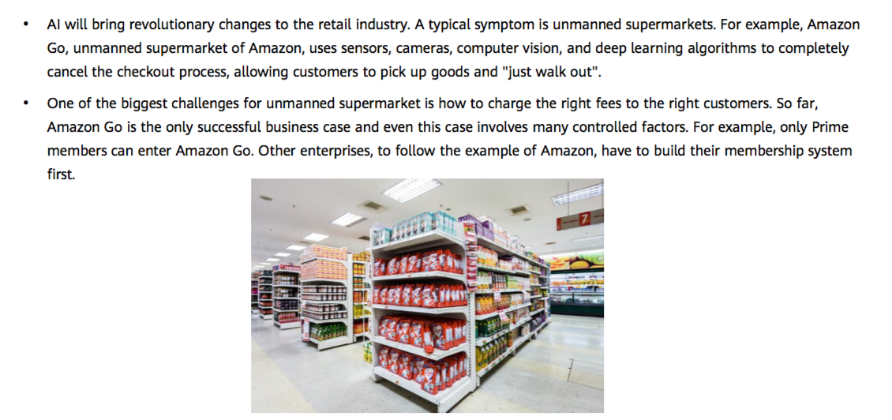
AI Application field- Retail

Slide 39
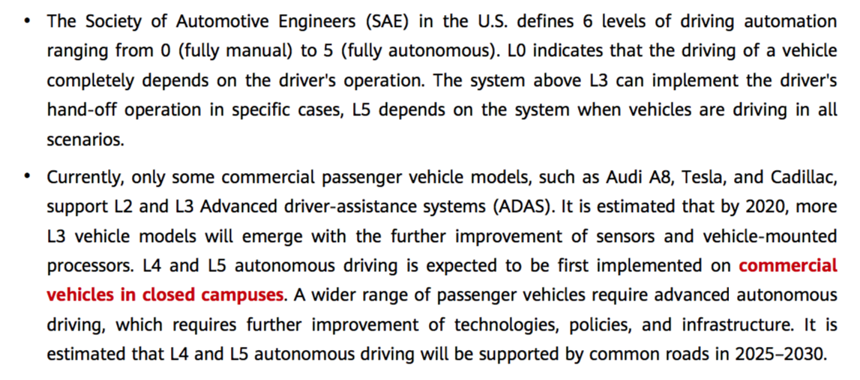
AI Application field- Autonomous Driving
Notes:
ALVINN: An Autonomous Land Vehicle in a Neural Network

Slide 40
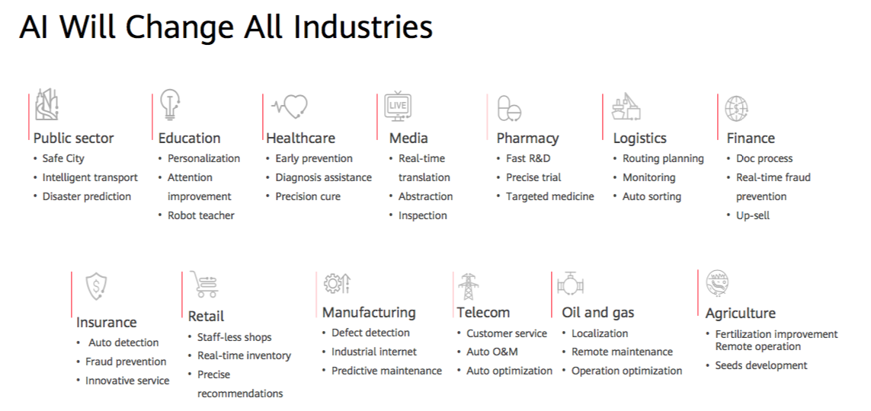

Slide 41
END
QUESTIONS/ COMMENTS/FEEDBACK

